Slide 1


Service
SAP Business One®
Service
mobile app
SAP Business One®

Slide 2
Service
SAP Business One®
Provide on-site services for customers by easily and efficiently reviewing and resolving assigned service tickets.

Slide 3
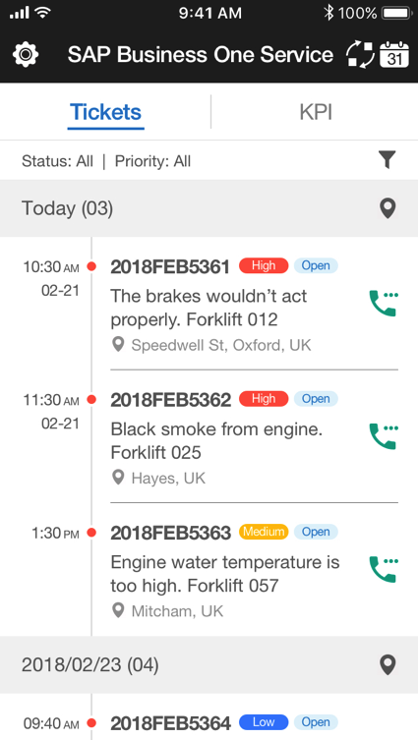
Tickets
View your tickets
Filter tickets
Check and synchronize tickets in your monthly calendar

Slide 4
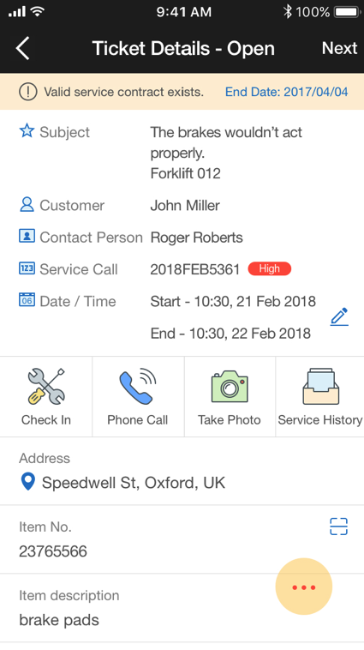
Ticket Details
Efficiently manage and resolve your service tickets online or offline

Slide 5
Ticket Details
Review service contract details

Slide 6
Ticket Details
Check-in And Check-out
Remote worker safety feature

Slide 7
Ticket Details
Phone Call
Easily call your customer

Slide 8
Ticket Details
Take A Photo
Capture important details or images for an open service ticket

Slide 9
Ticket Details
Service History
View a list of all other service call records

Slide 10
Ticket Details
Location
Check the customer’s address on a map

Slide 11
Ticket Details
Scan An Item
Scan a barcode or QR code
Identify an item by its serial number manufacturer

Slide 12
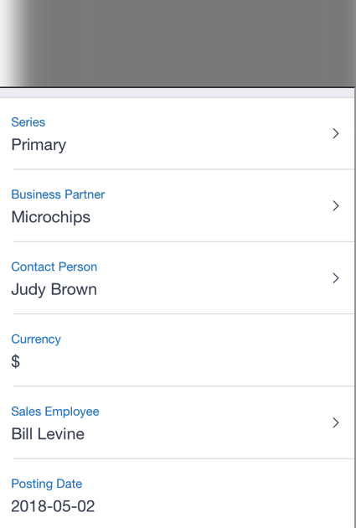
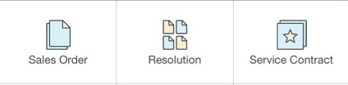

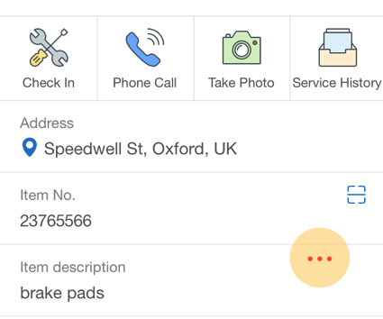
Ticket Details
Sales Orders
Easily view, edit, create, duplicate and cancel sales orders

Slide 13

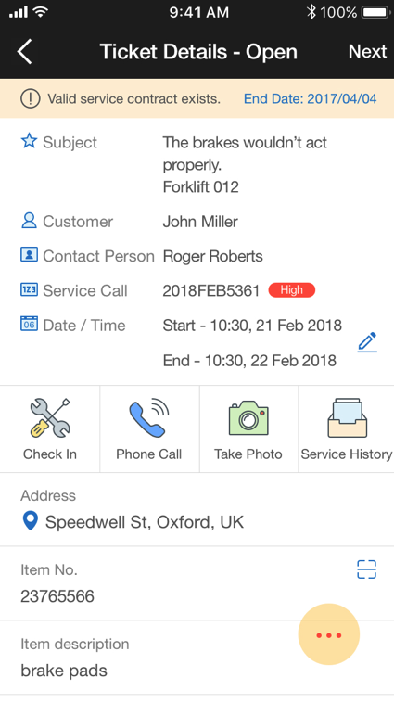
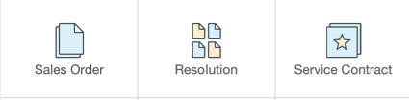
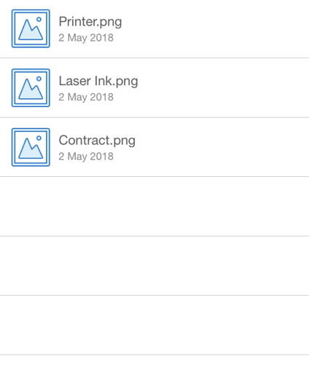
Ticket Details
Attachment
Include important details of a service call relating to your service ticket

Slide 14
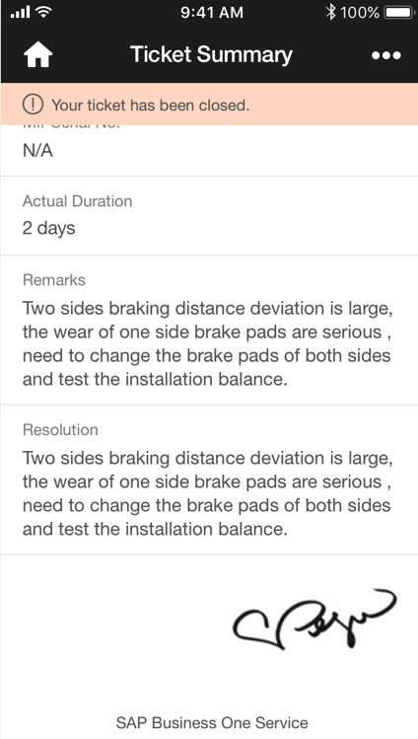
Ticket Summary
Review and capture a report for your service ticket

Slide 15
Ticket Summary
View and confirm the service ticket details

Slide 16
Ticket Summary
Capture a customer signature on your phone screen

Slide 17
Ticket Summary
Create a PDF report

Slide 18
Ticket Summary
Print the ticket summary in a portable Bluetooth thermal printer

Slide 19



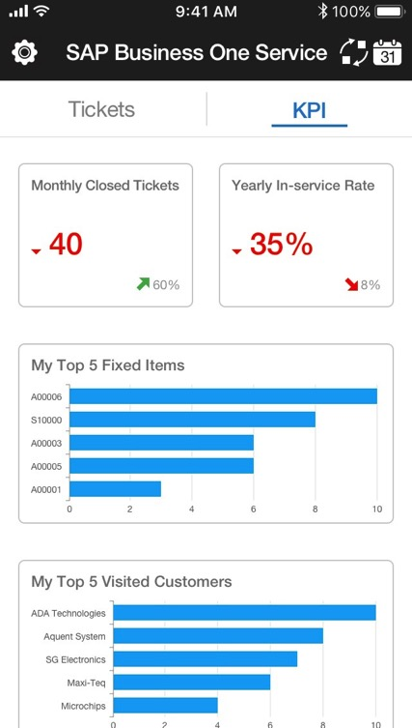

View Key Performance Indicators
View monthly closed tickets
Yearly in-service rate
Top 5 items serviced and fixed
Top 5 most visited customers
Customize the KPI dashboard for your business

Slide 20
Technical Information
Service mobile app
SAP Business One®
SAP Business One®
Service
For Apple iOS:
SAP Business One v9.3 PL04 version for SAP HANA
Apple iPhone 5 or later, iOS8 or later
For SAP Business One Cloud:
SAP Business One Cloud 1.1 PL09
SAP Business One 9.3 PL04, version for SAP HANA
Available in 28 languages

Slide 21
Technical Information continued:
Supports:
Service Layer, SAP Business One Analytics and Framework
License types:
Professional, Limited CRM and Mobile Service
Security:
Basic access authentication at logon, license-based function-level and user-based data-level authorization (data ownership), valid SSL certificates enforced, Apple Face/Touch ID
SAP Business One®
Service

Slide 22
Summary
Service mobile app
SAP Business One®
SAP Business One®
Service
Streamlined job management for mobile technicians
Easy set-up and user-friendly
SAP Business One powered by SAP HANA analytics
Affordable licensing options
Comprehensive security
Available in 28 languages

Slide 23
SAP Business One®
Service
mobile app

